Slide 1

APEX INSTITUTE OF TECHNOLOGY
DEPARTMENT OF COMPUTER SCIENCE & ENGINEERING
MACHINE LEARNING (21CSH-286)
Faculty: Prof. (Dr.) Vineet Mehan (E13038)
Lecture – 4
Data Pre-Processing
DISCOVER . LEARN . EMPOWER

Slide 2
DBMS: Course Objectives
COURSE OBJECTIVES
The Course aims to:
Understand and apply various data handling and visualization techniques.
Understand about some basic learning algorithms and techniques and their applications, as well as general questions related to analysing and handling large data sets.
To develop skills of supervised and unsupervised learning techniques and implementation of these to solve real life problems.
To develop basic knowledge on the machine techniques to build an intellectual machine for making decisions behalf of humans.
To develop skills for selecting suitable model parameters and apply them for designing optimized machine learning applications.

Slide 3
COURSE OUTCOMES
On completion of this course, the students shall be able to:-
CO1 | Understand machine learning techniques and computing environment that are suitable for the applications under consideration.

Slide 4
Unit-1 Syllabus
Unit-1 | Introduction to Machine Learning
Introduction to Machine Learning | Definition of Machine Learning, Working principles of Machine Learning; Classification of Machine Learning algorithms: Supervised Learning, Unsupervised Learning, Reinforcement Learning, Semi-Supervised Learning; Applications of Machine Learning.
Data Pre-Processing and Feature Extraction | Data Sourcing and Cleaning, Handling Missing data, Encoding Categorical data, Feature Scaling, Handling Time Series data; Feature Selection techniques, Data Transformation, Normalization, Dimensionality reduction
Data Visualization | Data Frame Basics, Different types of analysis, Different types of plots, Plotting fundamentals using Matplotlib, Plotting Data Distributions using Seaborn.

Slide 5
SUGGESTIVE READINGS
TEXT BOOKS:
There is no single textbook covering the material presented in this course. Here is a list of books recommended for further reading in connection with the material presented:
T1: Tom.M.Mitchell, “Machine Learning, McGraw Hill International Edition”.
T2: Ethern Alpaydin,” Introduction to Machine Learning. Eastern Economy Edition, Prentice Hall of India, 2005”.
T3: Andreas C. Miller, Sarah Guido, Introduction to Machine Learning with Python, O’REILLY (2001).
REFERENCE BOOKS:
R1 Sebastian Raschka, Vahid Mirjalili, Python Machine Learning, (2014)
R2 Richard O. Duda, Peter E. Hart, David G. Stork, “Pattern Classification, Wiley, 2nd Edition”.
R3 Christopher Bishop, “Pattern Recognition and Machine Learning, illustrated Edition, Springer, 2006”.

Slide 6
Data Sourcing
For data sourcing Panda is used.
Panda is a python Library for analyzing data.
Name?
Panda = Panel Data + Python Data Analysis (Combination) gave the name.
Panel data is a subset of longitudinal data where observations are for the same subjects each time.

Slide 7
Data Sourcing
Use of Panda ?
Pandas allow us to analyze big data and make conclusions based on statistical theories.
Pandas can clean messy data sets, and make them readable and relevant.
Pandas are used in Data Science.

Slide 8
Data Sourcing
Data Science: is a branch of computer science where we study how to store, use and analyze data for deriving information from it.
How to install Pandas?
1. Open cmd prompt
2. Type
>>> python –m pip install pandas

Slide 9
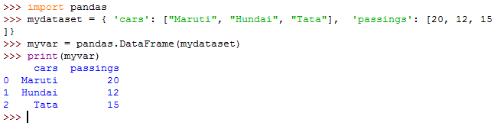
Make a data Frame that tells the type of vehicles that passed a toll plaza.
import pandas
mydataset = { 'cars': ["Maruti", "Hundai", "Tata"], 'passings': [20, 12, 15]}
myvar = pandas.DataFrame(mydataset)
print(myvar)

Slide 10
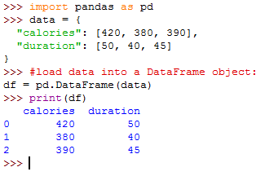
Import pandas as pd and use pd

Slide 11
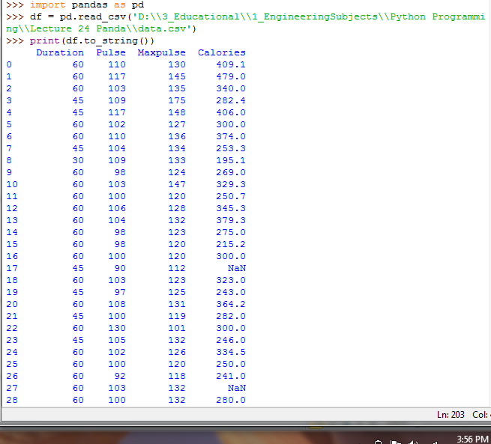
Read data from a CSV File

Slide 12
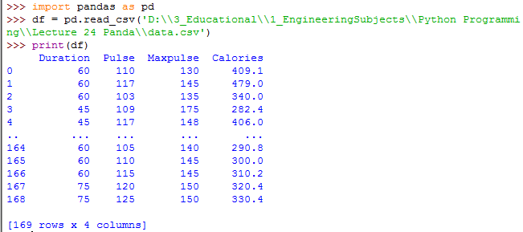
Reading CSV but print without converting to string

Slide 13

Checking the pandas version

Slide 14
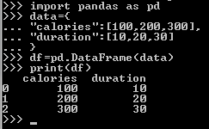
Pandas Data Frames
A Pandas DataFrame is a 2 dimensional data structure, like a 2 dimensional array, or a table with rows and columns.
Create a simple Panda Data Frame

Slide 15
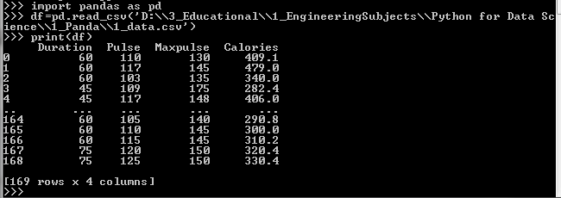
Load the CSV file into data Frame

Slide 16
Data Cleaning
Data cleaning means fixing bad data in your data set.
Bad data could be:
Empty cells
Data in wrong format
Wrong data
Duplicates

Slide 17
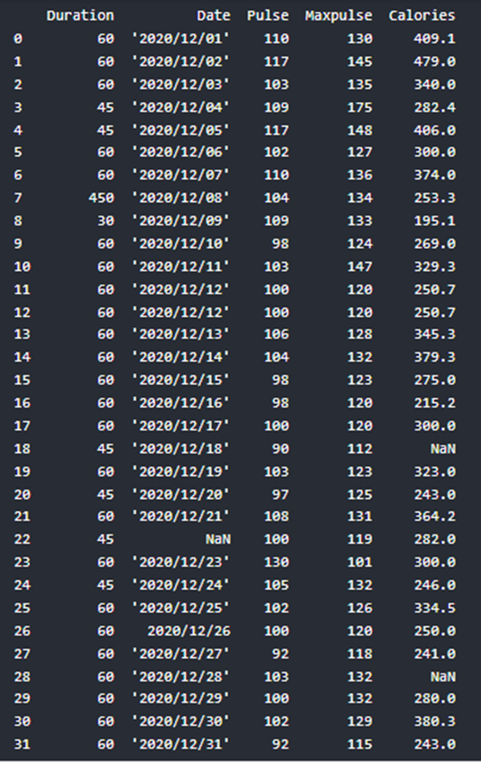
The data set contains some empty cells ("Date" in row 22, and "Calories" in row 18 and 28).

Slide 18
The data set contains wrong format ("Date" in row 26).

Slide 19
The data set contains wrong data ("Duration" in row 7).

Slide 20
The data set contains duplicates (row 11 and 12).

Slide 21
1. Remove Rows
One way to deal with empty cells is to remove rows that contain empty cells.
This is usually OK, since data sets can be very big, and removing a few rows will not have a big impact on the result.
See Row 17 and 27 (removed)

Slide 22
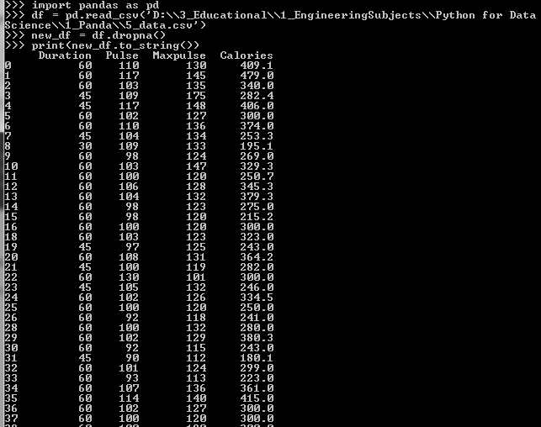
Pandas dropna() method allows the user to analyze and drop Rows/Columns with Null values
By default, the dropna() method returns a new DataFrame, and will not change the original.

Slide 23
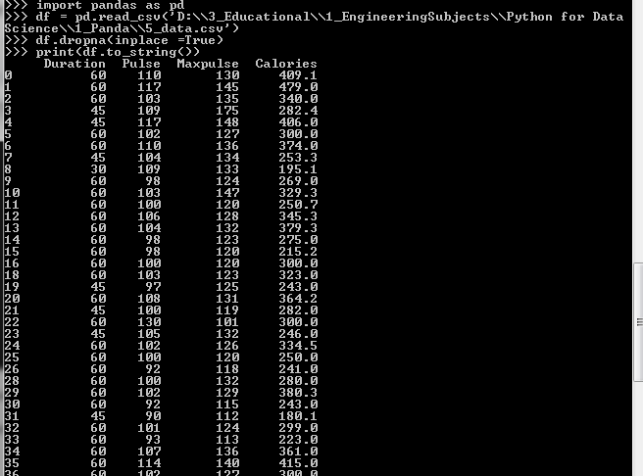
By default, the dropna() method returns a new DataFrame, and will not change the original.
If you want to change the original DataFrame, use the inplace = True argument.

Slide 24
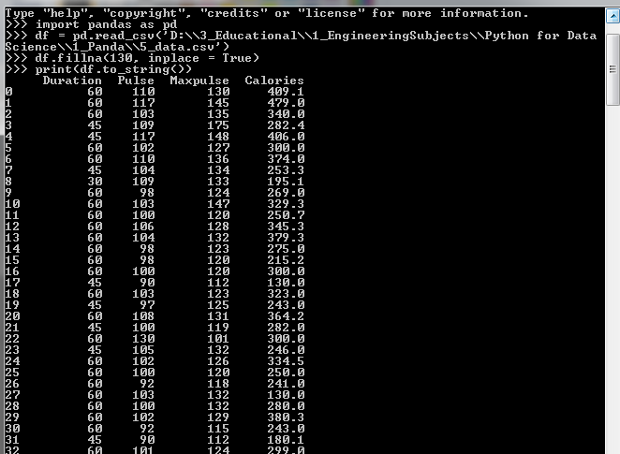
3. Replace Empty Values
See Row 17 replaced with 130
The fillna() method allows us to replace empty cells with a value.
It will Replace NULL values with the number 130.

Slide 25
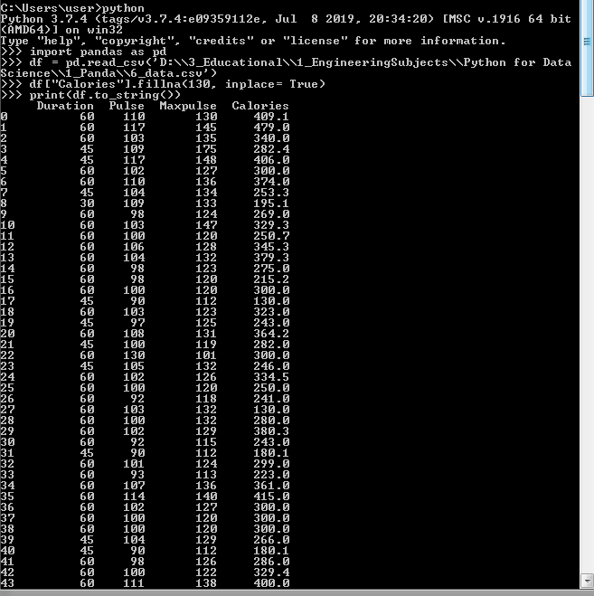
4. Replace value in a particular column
Values are replaced at position 17, 27, 91, 118, and 141 in the Calories column only.

Slide 26
5. Replace Using Mean, Median, or Mode
A common way to replace empty cells, is to calculate the mean, median or mode value of the column.
Mean → Average
Median → Center value
Mode → Most common occurring value

Slide 27
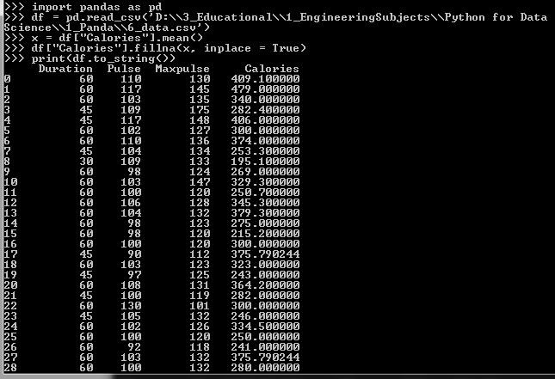
Empty Values are replaced with mean at position 17, 27, 91, 118, and 141 in the Calories column only.
Mean here is 375.790244

Slide 28
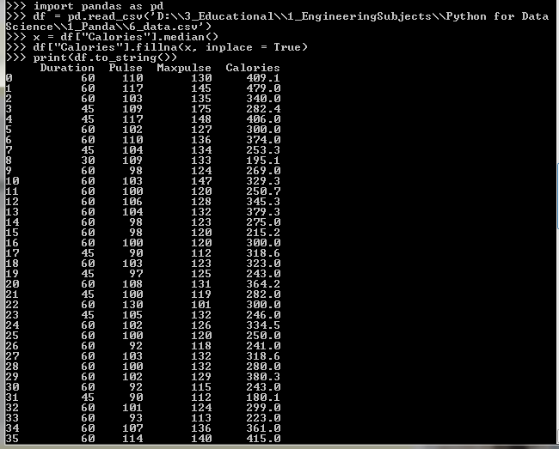
Empty Values are replaced with median at position 17, 27, 91, 118, and 141 in the Calories column only.
Median here is 318.6

Slide 29
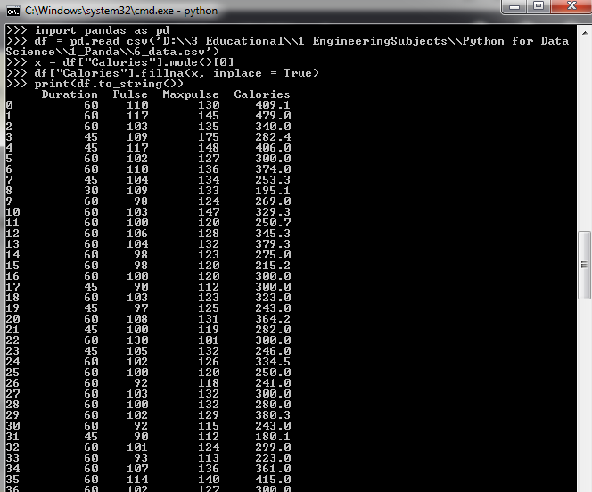
Empty Values are replaced with mode at position 17, 27, 91, 118, and 141 in the Calories column only.
Mode here is 300.0

Slide 30
Wrong Data
"Wrong data" does not have to be "empty cells" or "wrong format", it can just be wrong, like if someone registered "199" instead of "1.99".
Sometimes you can spot wrong data by looking at the data set, because you have an expectation of what it should be.
If you take a look at our data set, you can see that in row 7, the duration is 450, but for all the other rows the duration is between 30 and 60.

Slide 31
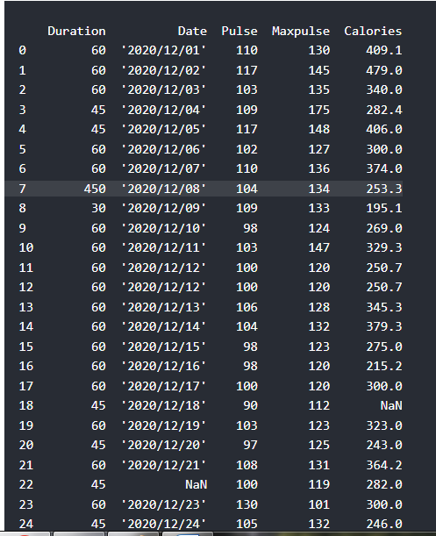

Slide 32
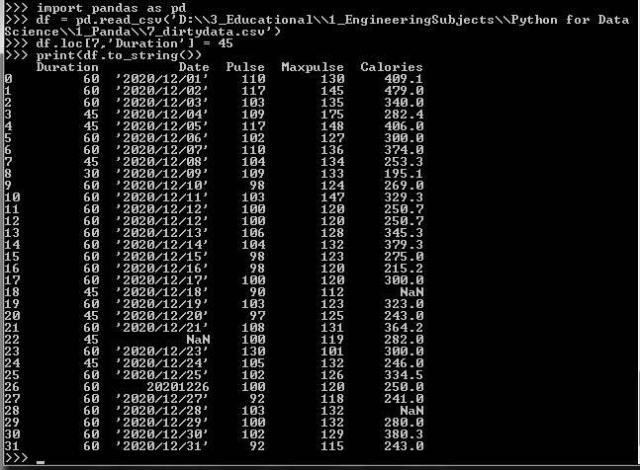
One way to fix wrong values is to replace them with something else.
In our example, it is most likely a typo, and the value should be "45" instead of "450", and we could just insert "45" in row 7:

Slide 33
For Larger Data
For small data sets you might be able to replace the wrong data one by one, but not for big data sets.
To replace wrong data for larger data sets you can create some rules, e.g. set some boundaries for legal values, and replace any values that are outside of the boundaries.

Slide 34
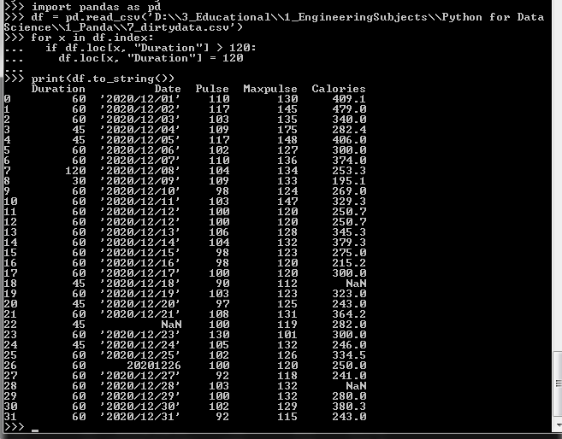

Slide 35
Removing Rows
Another way of handling wrong data is to remove the rows that contains wrong data.
This way you do not have to find out what to replace them with, and there is a good chance you do not need them to do your analyses.
Value at position no 7 is removed

Slide 36
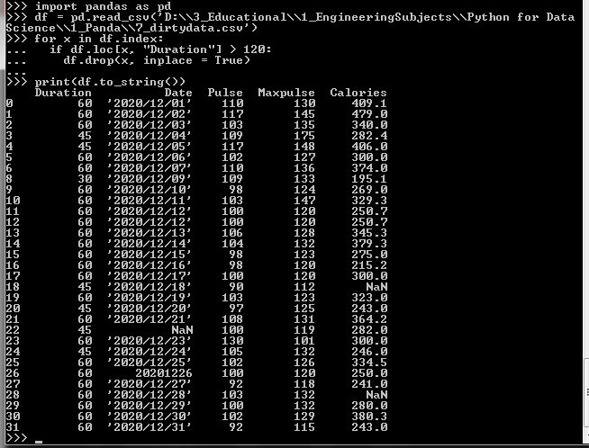

Slide 37
Duplicate Data
Duplicate rows are rows that have been registered more than one time.
By taking a look at our test data set, we can assume that row 11 and 12 are duplicates.
To discover duplicates, we can use the duplicated() method.
The duplicated() method returns a Boolean values for each row.

Slide 38
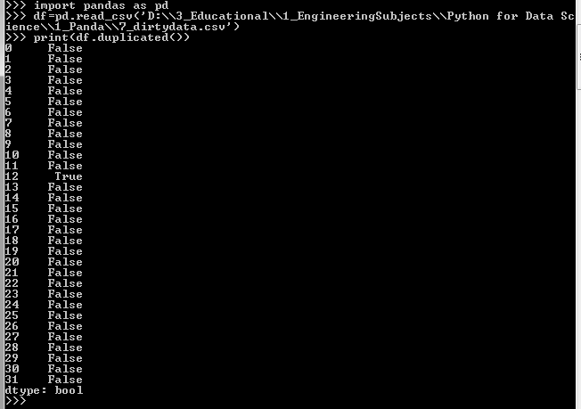
Above program Returns True for every row that is a duplicate, otherwise False

Slide 39
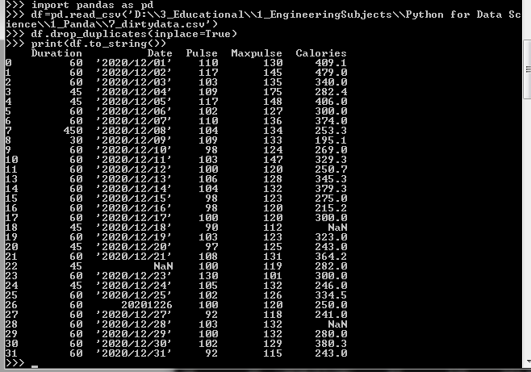
Removing Duplicates
To remove duplicates, use the drop_duplicates() method.
The duplicate row (row no 12) is now removed

Slide 40
Summary
Methods of Sourcing Data
Methods of Cleaning Data

Slide 41
Task
Applying various methods that are used for sourcing the data by taking a suitable arrays\datasets etc. (BT-Level3)
Design a model that is used to clean Empty cells, Data in wrong format, Wrong data, and Duplicates. (BT-Level6)

Slide 42
REFERENCES
https://www.javatpoint.com/machine-learning
https://www.tutorialspoint.com/machine_learning/index.htm
https://www.w3schools.com/python/

Slide 43
THANK YOU
For queries
Email: vineet.e13038@cumail.in

